Slide 1
Impact of Product packaging on consumer buying behaviour in the fmcg sector
Noor Raza

Slide 2
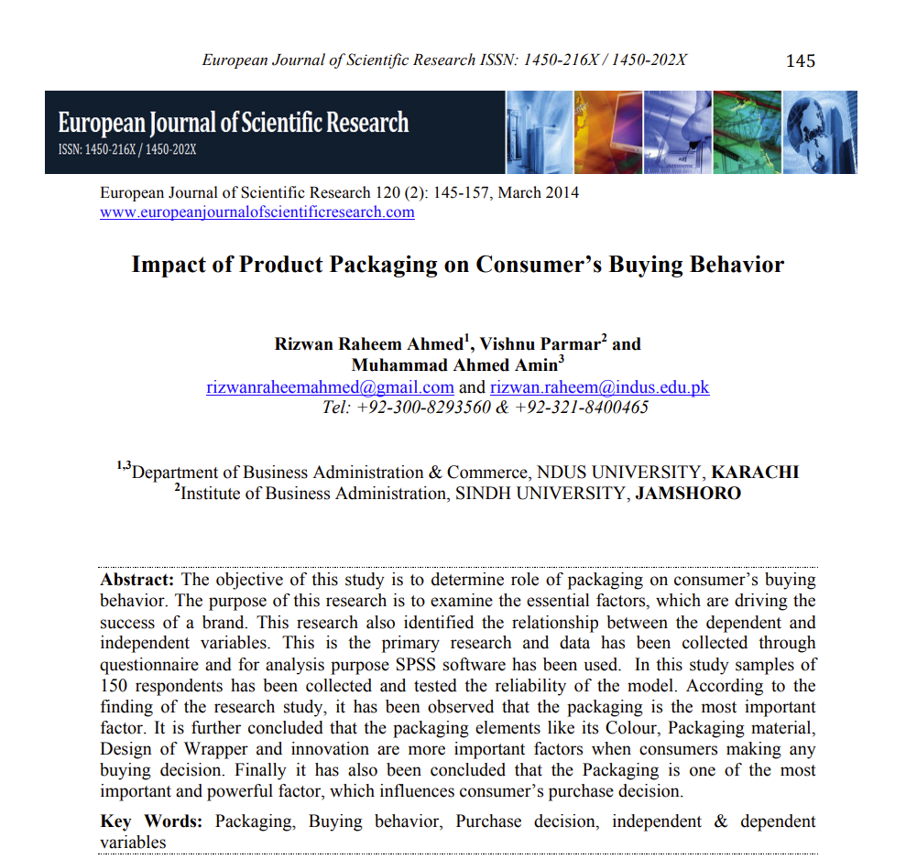
1

Slide 3
1
Name of Topic | Impact of product packaging on consumer’s buying behaviour
Journal | European Journal of Scientific Research
Year of Publication | 2014
Hypothesis | To identify the role of packaging on consumer buying behaviour decision
Data source | Theoretical framework, primary data (survey) and secondary data
Type of Analysis | Quantitative-SPSS
Major Variables | Packaging colour, material, wrapper, innovation and consumer buying behavior

Slide 4
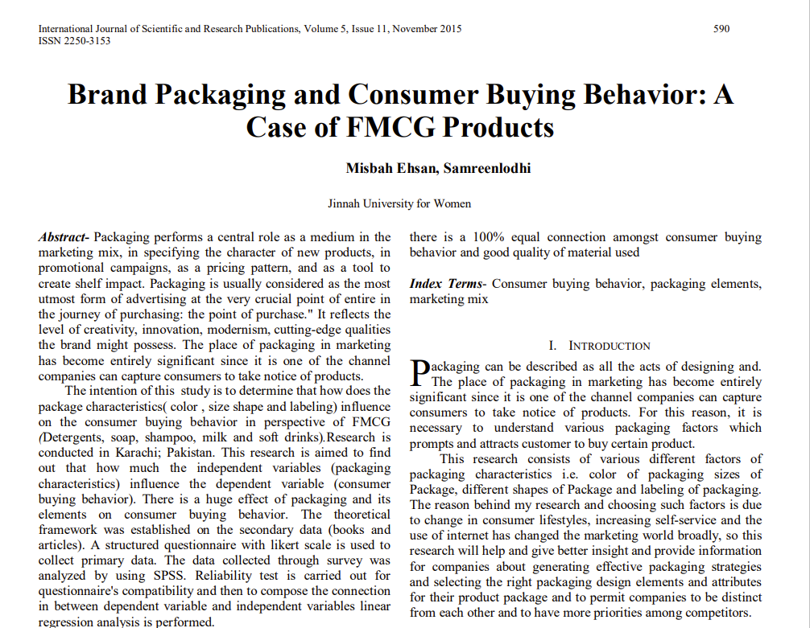
2

Slide 5
2
Name of Topic | Brand Packaging and Consumer Buying Behavior: A Case of FMCG Products
Journal | International Journal of Scientific and Research Publications
Year of Publication | 2015
Hypothesis | Influence of packaging elements on buying behavior
Data source | Primary (survey) and secondary data
Type of Analysis | Quantitative-SPSS and Bar charts
Major Variables | Packaging shape, colour, size, labelling

Slide 6
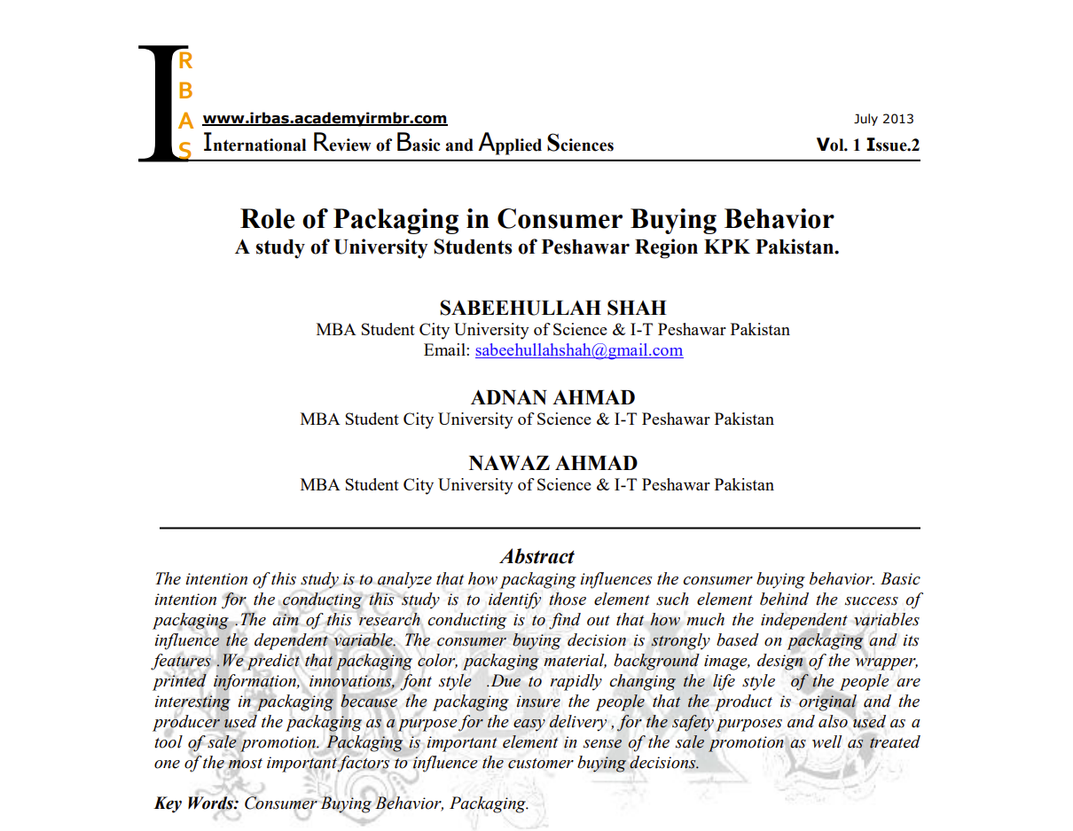
3

Slide 7
3
Name of Topic | Role of Packaging in Consumer Buying Beahavior: A study of university students of Peshawar Region KPK Pakistan
Journal | International Review of Basic and Applied Sciences
Year of Publication | 2013
Hypothesis | There is relation between packing color/material/font style/printed information/innovation and consumer buying behavior
Data source | Primary (survey) and secondary data
Type of Analysis | Quantitative-Regression Analysis
Major Variables | packing color/material/font style/printed information/innovation and consumer buying behavior

Slide 8
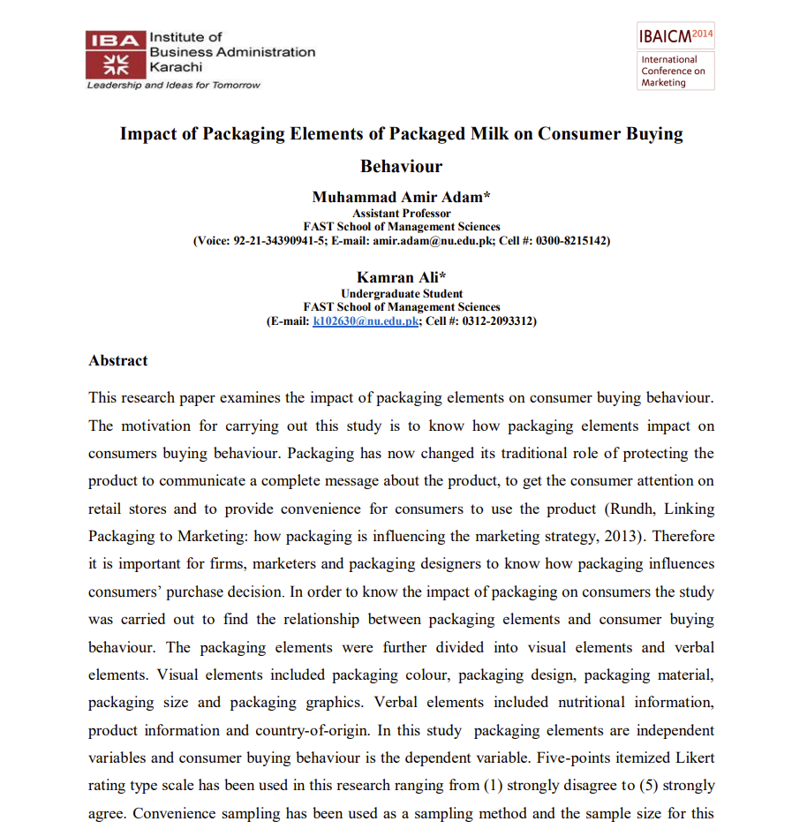
4

Slide 9
4
Name of Topic | Impact of Packaging Elements of Packaged Milk on Consumer Buying Behaviour
Journal | IBA International Conference on Marketing
Year of Publication | 2014
Hypothesis | Visual and verbal elements of packaged milk have an impact on consumer buying behaviour
Data source | Primary and secondary
Type of Analysis | Quantitative-Pearson, multiple regression, ANOVA and qualitative
Major Variables | Visual elements- size, graphics, colour, design, material, Verbal elements- product information, nutritional information, country of origin and consumer buying behaviour

Slide 10
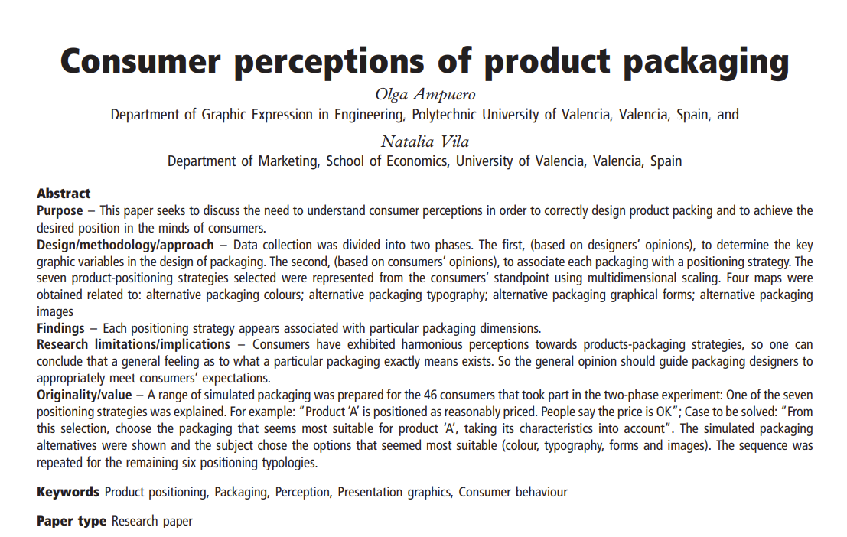
5

Slide 11
5
Name of Topic | Consumer perceptions of product packaging
Journal | Journal of consumer marketing
Year of Publication | 2006
Hypothesis | Consumers’ perceptions towards products will vary according to the packaging strategies defined for these products.
Data source | Primary (interviews) and secondary data
Type of Analysis | Qualitative and quantitative-maps related to alternative packaging colours; alternative packaging typography; alternative packaging graphical forms; alternative packaging images
Major Variables | colour, typography, shape, image

Slide 12
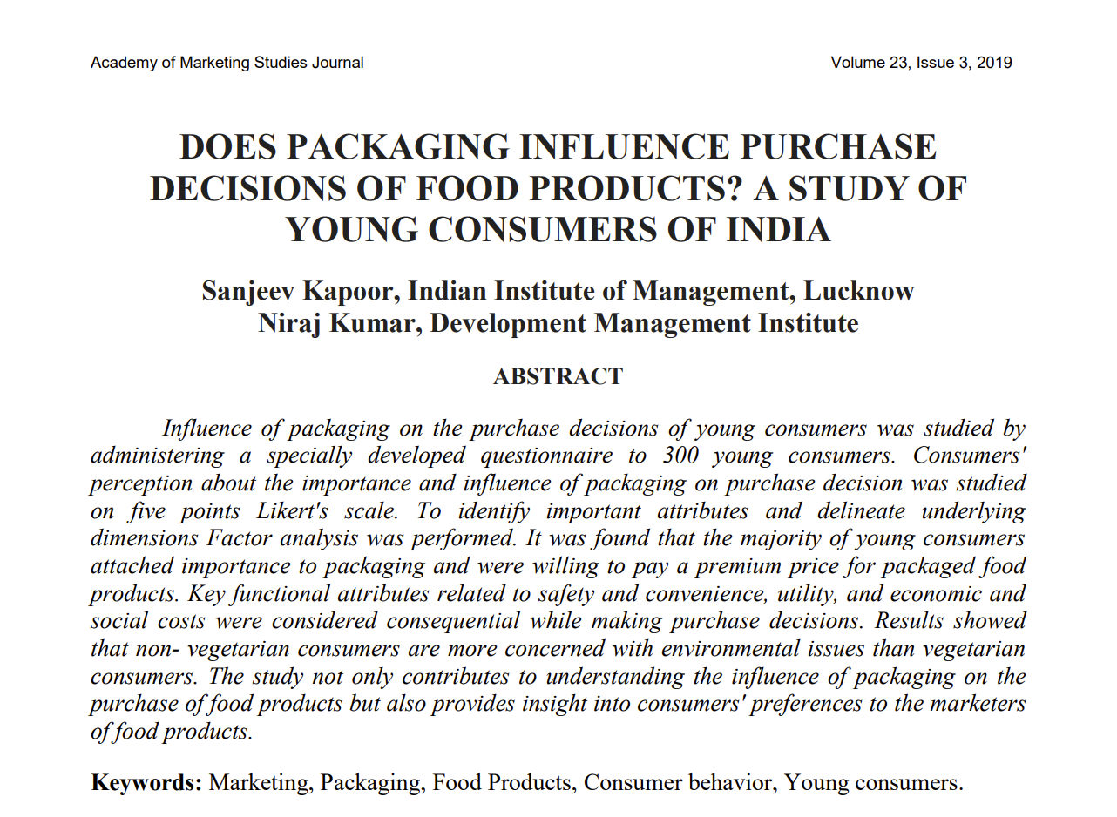
6

Slide 13
6
Name of Topic | Does Packaging Influence Purchase Decisions of Food Products?
Journal | Academy of Marketing Studies Journal
Year of Publication | 2019
Hypothesis | Do young consumers attach importance to food packaging in their purchase decisions? What are the primary functional attributes of packaging as preferred by the young consumers of food products? Do the demographic characteristics of consumers’ influences their preferences for packaging attributes for food products?
Data source | Primary (questionnaire) and secondary data
Type of Analysis | Qualitative and quantitative-Likert scale and ANOVA
Major Variables | Packaging and purchase decision

Slide 14
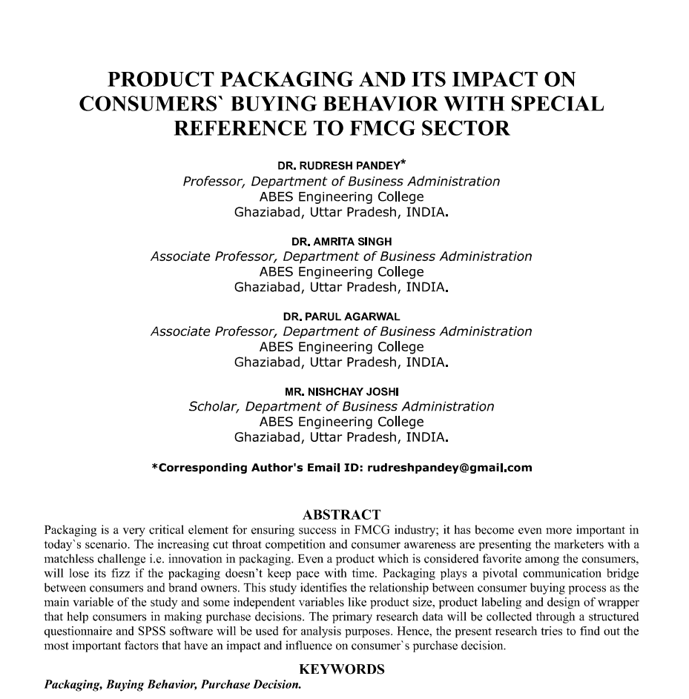
7

Slide 15
7
Name of Topic | Product Packaging and its impact on consumers' buying behaviour with special reference to FMCG sector
Journal | VSRD International Journal of Business and Management Research
Year of Publication | 2019
Hypothesis | Packaging of FMCG products has an impact on consumer buying behavior.
Data source | Primary (questionnaire) and secondary data
Type of Analysis | Quantitative-SPSS
Major Variables | Product size, labelling, design of wrapper and consumer buying behaviour

Slide 16
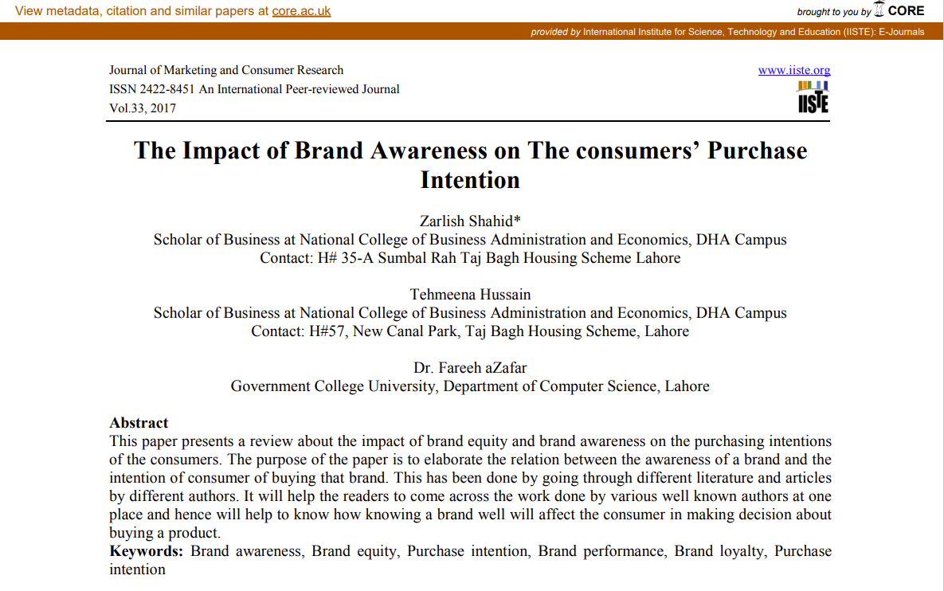
8

Slide 17
8
Name of Topic | The Impact of Brand Awareness on the consumers’ purchase intention
Journal | Journal of Marketing and Consumer Research
Year of Publication | 2017
Hypothesis | Brand awareness has an impact on purchase intention
Data source | Theoretical framework and secondary data
Type of Analysis | Qualitative
Major Variables | Brand awareness, name, advertising and purchase intention

Slide 18
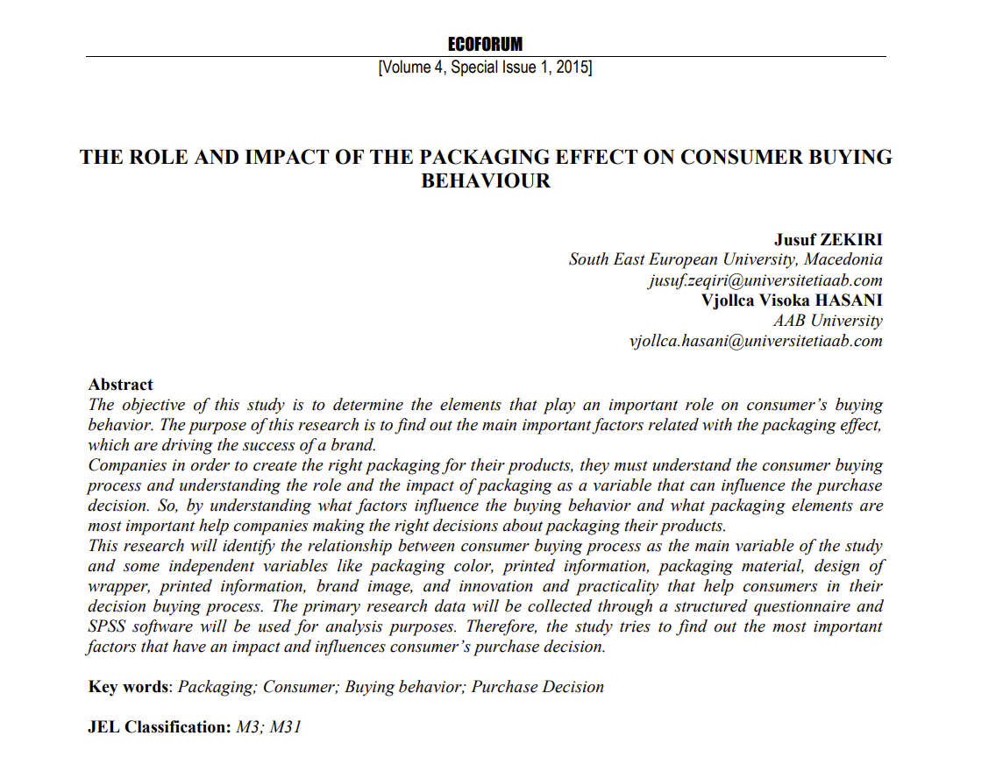
9

Slide 19
9
Name of Topic | The role and impact of the packaging effect on consumer buying behaviour
Journal | Eco-forum
Year of Publication | 2015
Hypothesis | Packaging color, labelling, wrapper, brand image, innovation has an impact on the buying behavior of consumers
Data source | Primary (questionnaire) and secondary data
Type of Analysis | Quantitative-SPSS
Major Variables | Packaging color, labelling, wrapper, brand image, innovation and practicality

Slide 20
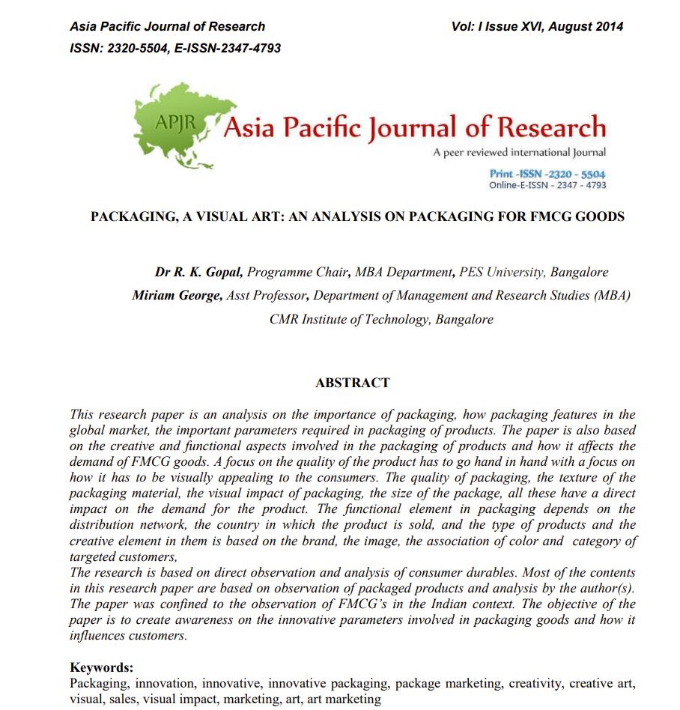
10

Slide 21
10
Name of Topic | Packaging, A visual art: An analysis on packaging for FMCG goods
Journal | Asia Pacific Journal of Research
Year of Publication | 2014
Hypothesis | To identify and analyze the functional aspect and creative aspects in packaging
Data source | Observational research
Type of Analysis | Qualitative
Major Variables | Packaging elements-colour, design, brand image, logo and functional aspects like segmented and brand packaging

